Slide 1
Assignment 2 - Requirements
by TA Sam Wang
112-2

Slide 2

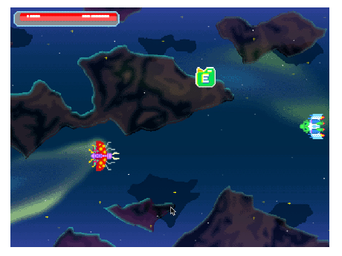
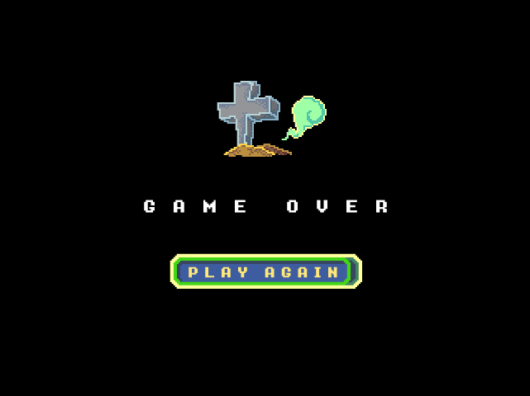

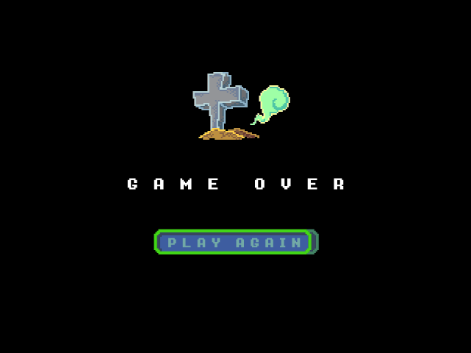
Assignment 2 (Due: 3/31 12pm)
Fork assignment here.
CLICK
GAME_START
GAME_RUN
GAME_LOSE
CLICK
Health Depleted

Slide 3
Requirements
1-star
Complete all requirements in assign1
Implement the game flow (GAME_START, GAME_RUN, GAME_LOSE), and ensure that each screen functions properly. We will use keys ‘1, 2, 3’ to check the game state.
Player can move smoothly using the arrow keys and cannot move off-screen.
2-star
Display the health bar with a range of 0-100 and the length of the bar should be proportional to the health value.
The player loses 20 health points when hit by an enemy, and gains 10 health points when they collect a treasure.
The enemy or treasure will disappear once they collide with the player's spaceship. The enemy will then reappear on the left side of the screen, and the treasure will randomly appear at any point on the screen. Hint: use AABB collision detection algorithm
3-star
The enemy can only fly from left to right, but it will accelerate towards the player when the distance between them is less than 300 pixels.] Hint: dist()

Slide 4


AABB Collision Detection
AABB (Axis-Aligned Bounding Boxes):
The algorithm checks four conditions to determine whether the boxes intersect:
A.left <= B.right
A.right >= B.left
A.top <= B.bottom
A.bottom >= B.top
A
B
B
A
Notes:
A物的左側在B物右側的左方
A物的右側在B物左側的右方
A物的上側在B物下側的上方
A物的下側在B物上側的下方

Slide 5
AABB Collision Detection
AABB (Axis-Aligned Bounding Boxes):
The algorithm checks four conditions to determine whether the boxes intersect:
A.left <= B.right
A.right >= B.left
A.top <= B.bottom
A.bottom >= B.top
A
B
A
B
Notes:
A物的左側在B物右側的左方
A物的右側在B物左側的右方
A物的上側在B物下側的上方
A物的下側在B物上側的下方

Slide 6
AABB Collision Detection
AABB (Axis-Aligned Bounding Boxes):
The algorithm checks four conditions to determine whether the boxes intersect:
A.left <= B.right
A.right >= B.left
A.top <= B.bottom
A.bottom >= B.top
A
B
A
B
Notes:
A物的左側在B物右側的左方
A物的右側在B物左側的右方
A物的上側在B物下側的上方
A物的下側在B物上側的下方

Slide 7
AABB Collision Detection
AABB (Axis-Aligned Bounding Boxes):
The algorithm checks four conditions to determine whether the boxes intersect:
A.left <= B.right
A.right >= B.left
A.top <= B.bottom
A.bottom >= B.top
A
B
A
B
Notes:
A物的左側在B物右側的左方
A物的右側在B物左側的右方
A物的上側在B物下側的上方
A物的下側在B物上側的下方

